Slide 1
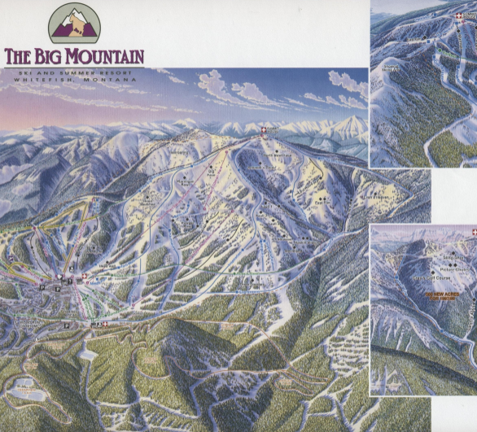

Vehicle Insurance Fraudulent Claim Detection Data Science Project
VISHAL RASTOGI
09/2022

Slide 2
PROBLEM STATEMENT
How can Data Science be leveraged to detect Vehicle Insurance Fraudulent claims to reduce losses on account of exaggerated and false claims about accidents, property damage and physical injury by developing machine learning models which can improve the accuracy as measured by F1 SCORE to above 0.8 in 6 months.
Scope:
One CSV File
Develop Models, only for accurately predicting false claims
Only valid for data with same feature space
Criteria for Success:
Explore factors contributing to fraudulent claims
Develop models to improve f1 score to 0.80
Key data sources
Csv File https://www.kaggle.com/shivamb/vehicle-claim-fraud-detection
Metadata
Constraints:
Only one csv file
Imbalanced data
Only categorical features
Stakeholders:
Executive Management Team

Slide 3
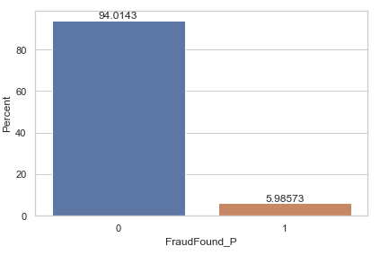
DATA WRANGLING
Data checked for missing values, type of data and data discrepancies
15420 rows and 33 columns
320 instances when the age is recorded as 0
All the columns except age in years is categorical
94.01 % of transactions are non-fraudulent and 5.99% transactions are fraudulent
FraudFound_P selected as target feature
Policy numbers looks randomly distributed and is just a serial number

Slide 4
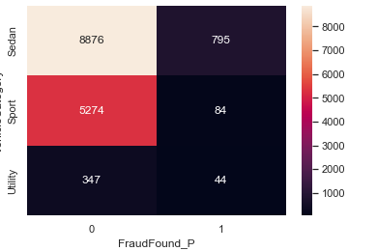
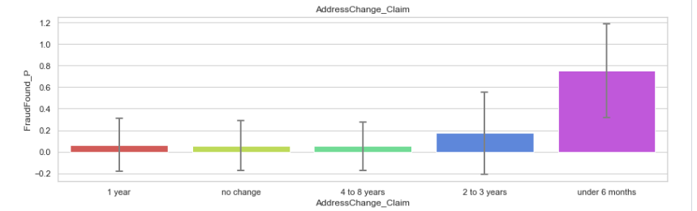
Exploratory Data Analysis
Key findings
Higher number of fraudulent transactions on Monday and Friday.
Males contributed 88.62% to fraudulent claims
Utility vehicles have higher probability of fraudulent claims in vehicle categories
Rural areas have higher probability of fraudulent claims
Highest probability of fraudulent claims is in higher end vehicles like Acura, BMW and Mercedes
Age group 30-40 has higher involvement in fraudulent activities
Higher probability of fraud if address is changed within last 6 months

Slide 5
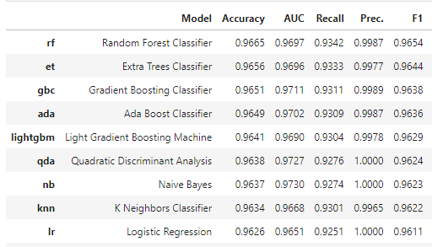
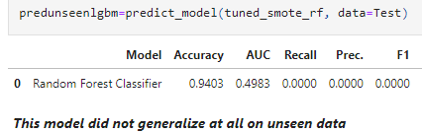
Preprocessing and Training Data
Step 1
Converted age column into 4 bins called age_bins
Dropped ‘PolicyNumber’, ‘RepNumber’ and ‘Age’ columns
Installed category_encoder, pycaret package,
Dummy encoded all categorical features
Used SMOTE , ADASYN, Random Over Sampler with PyCaret package
None of the models and combination generalized well on unseen data
Dummy Encoding+SMOTE USING PYCARET
Training Results
2. Validation Results

Slide 6

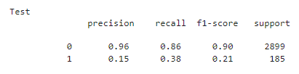
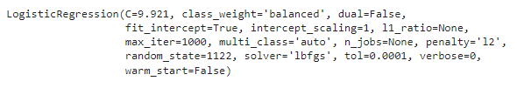
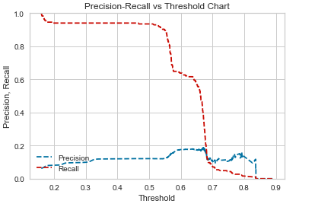
Preprocessing and Training Data
Step 2
1. Weight of Evidence Encoder with Logistic Regression Class Weight Optimization
Train Test Split with Stratified target column.
Used PyCaret for optimized Logistic Regression Model
Optimized class weight for f1 score using grid search CV:
Precision, Recall ,F1 Scores
Precision Recall Threshold Chart

Slide 7


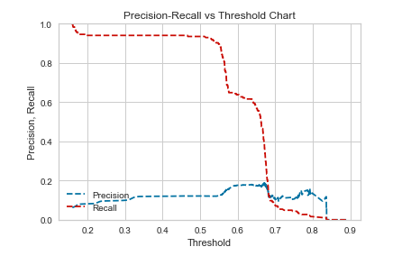
Preprocessing and Training Data
Step 2
1. CatBoost Encoder with Logistic Regression Class Weight Optimization
Train Test Split with Stratified target column.
Used PyCaret for optimized Logistic Regression Model
Optimized class weight for f1 score using grid search CV:
Precision, Recall ,F1 Scores
Precision Recall Threshold Chart

Slide 8


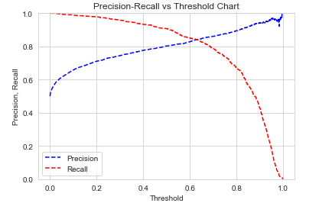

Modeling
Combination Modeling Approach:
SMOTEN for balancing
Weight of Evidence Encoder for encoding
Logistic Regression with Class Weight Optimization for Modeling
Optimized class weight for f1 score using grid search CV:
Precision, Recall ,F1 Scores
Precision Recall Threshold Chart

Slide 9
Conclusion
,
SMOTEN balancing combined with weight of evidence encoder, and tuned Logistic Regression model with class weight optimization, gave the best results and F1 score of 0.85 is achieved on minority class on validation data.
Dummy encoding approach did not generalize well due to too many features
Logistic regression with optimized class weight without balancing , generalized well but F1 score was only 0.22
Utility vehicles have higher probability of fraudulent claims in vehicle categories
Higher probability of fraud if address is changed within last 6 months
Higher end vehicles like Mercedes, BMW and Acura are more involved in fraudulent claims

Slide 10

THANK YOU

